Slide 1
Welcome to DCISD Technology

Slide 2
Cellular Email

Slide 3
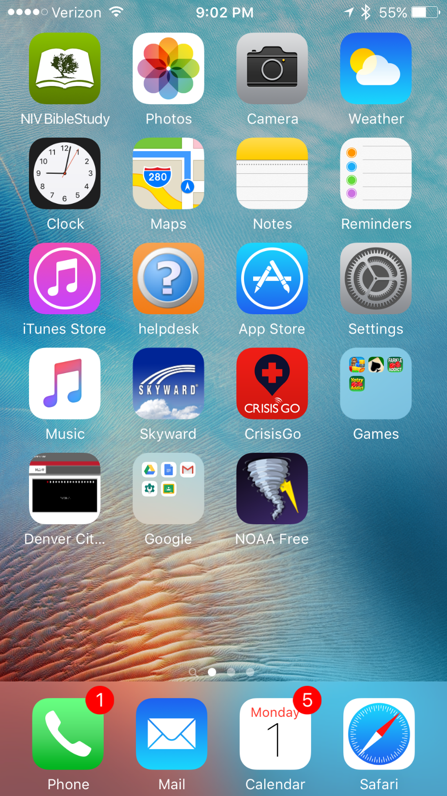
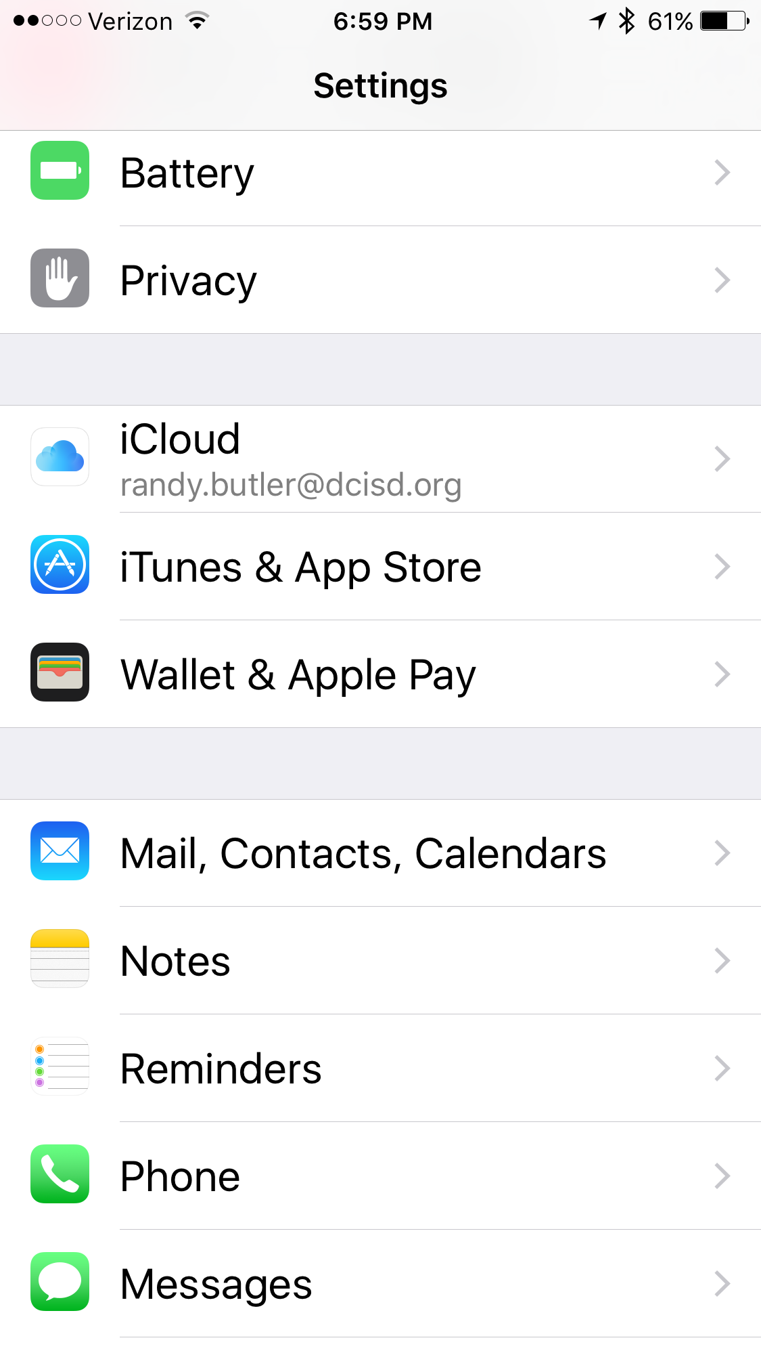
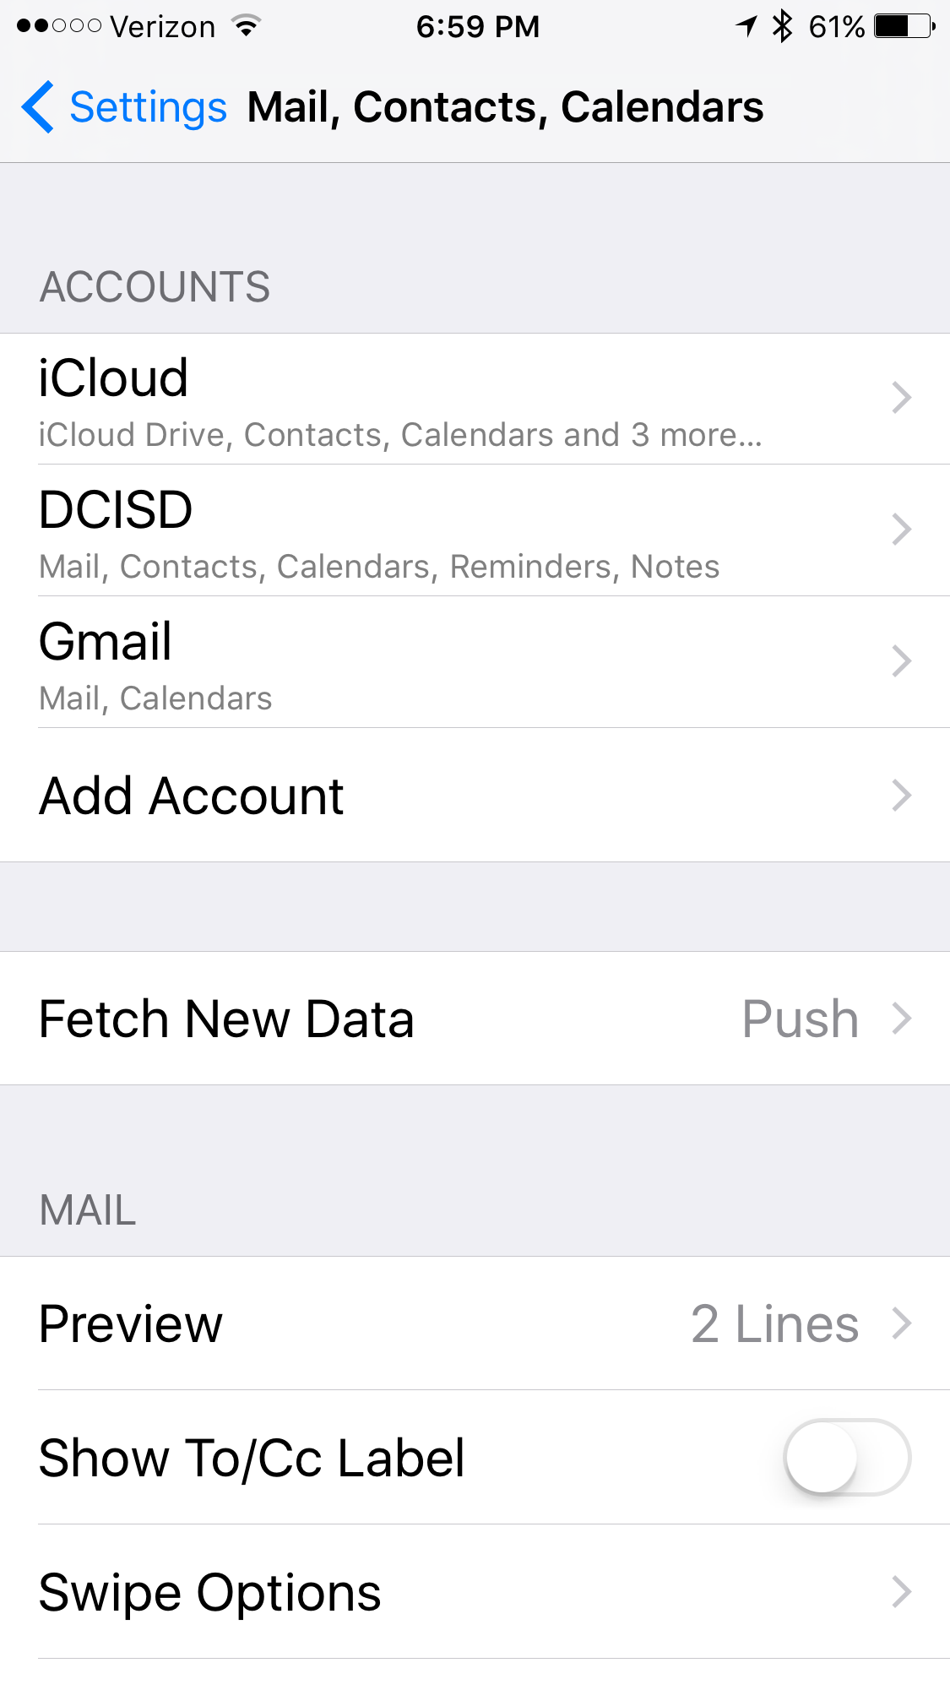

Slide 4
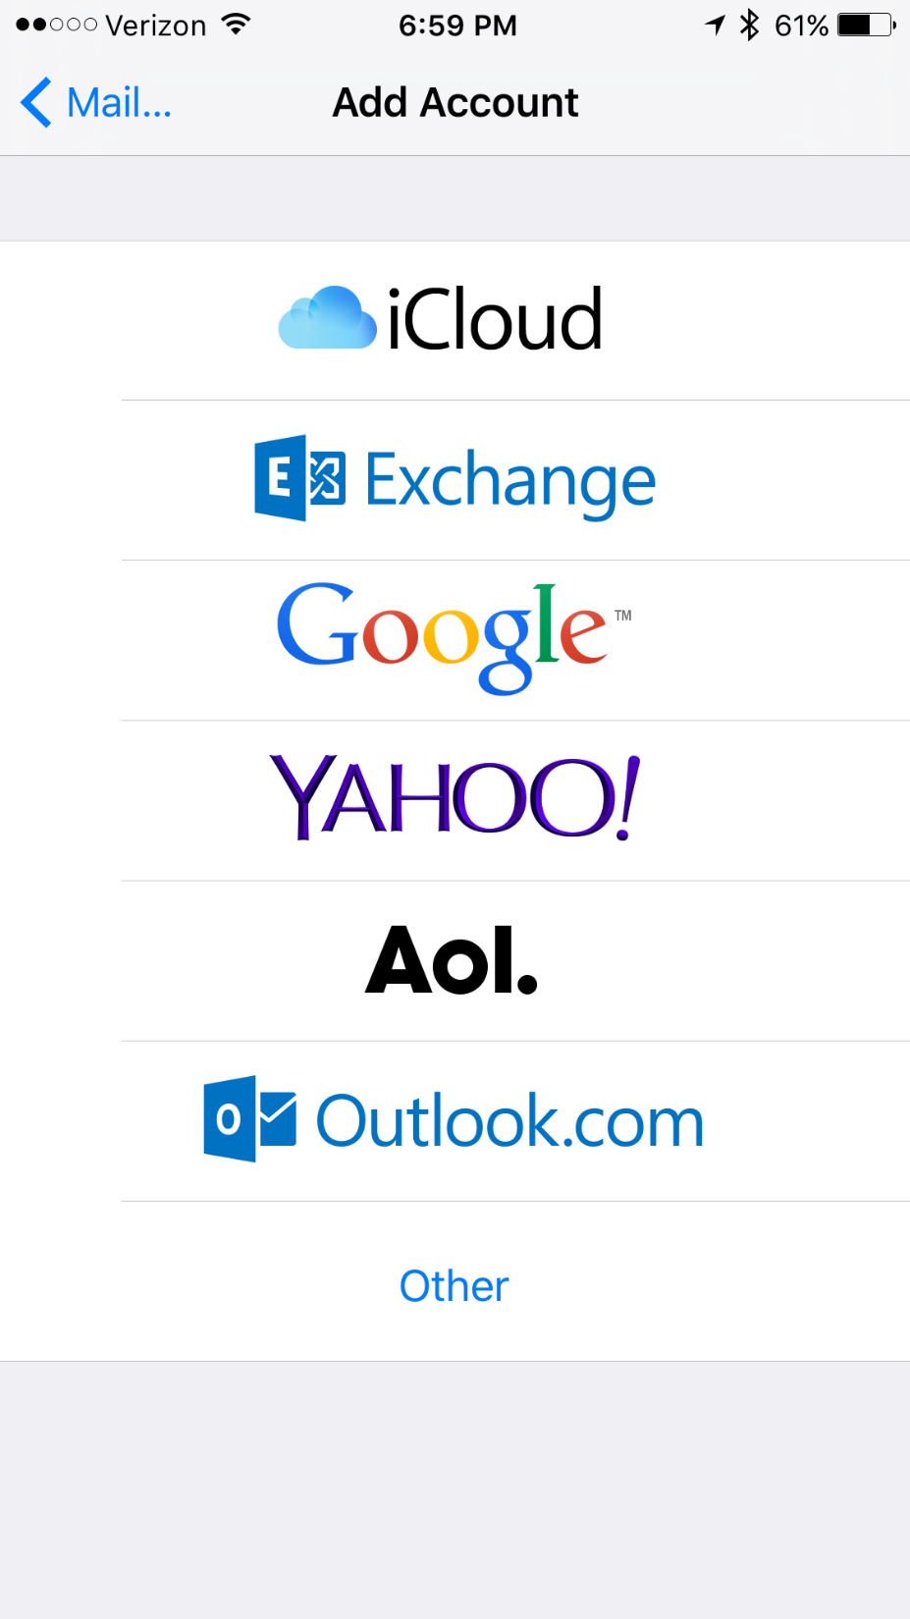
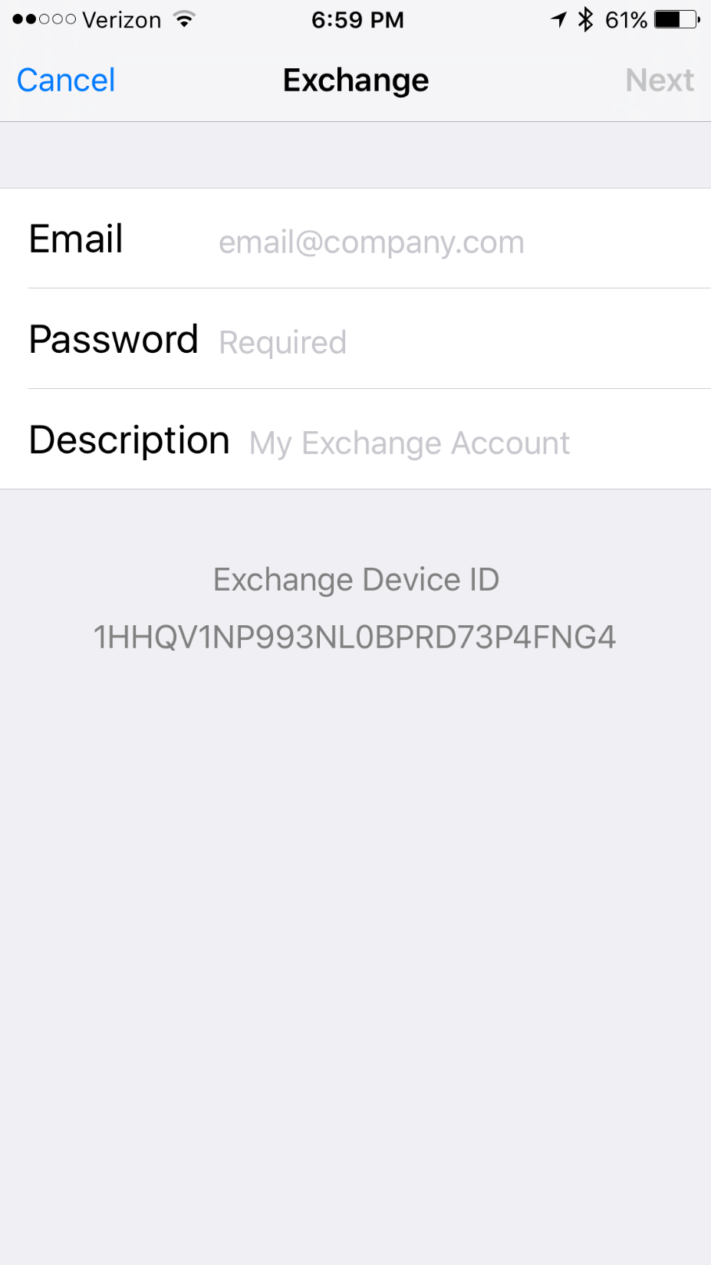

Slide 5
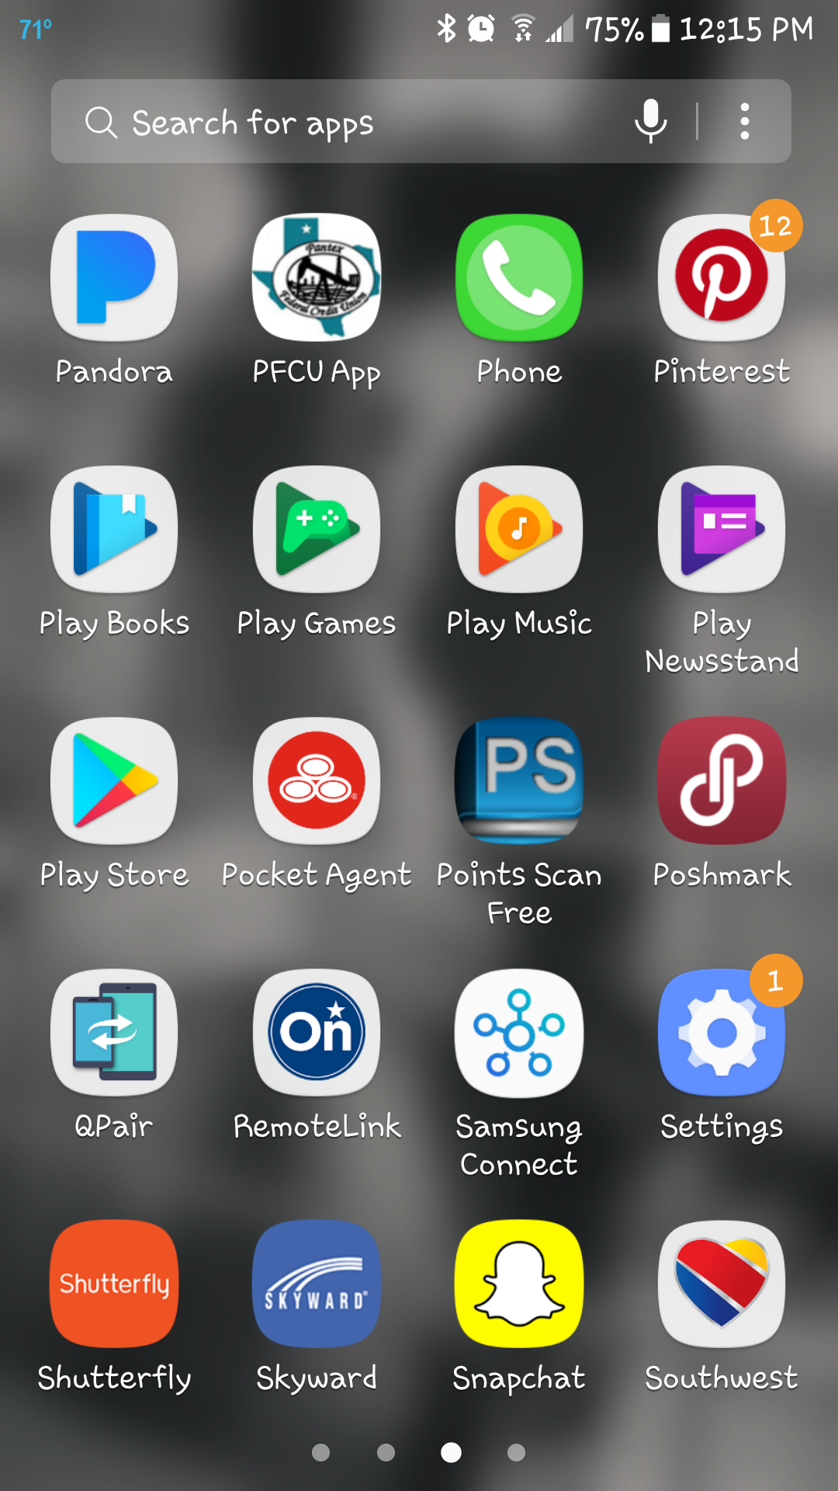
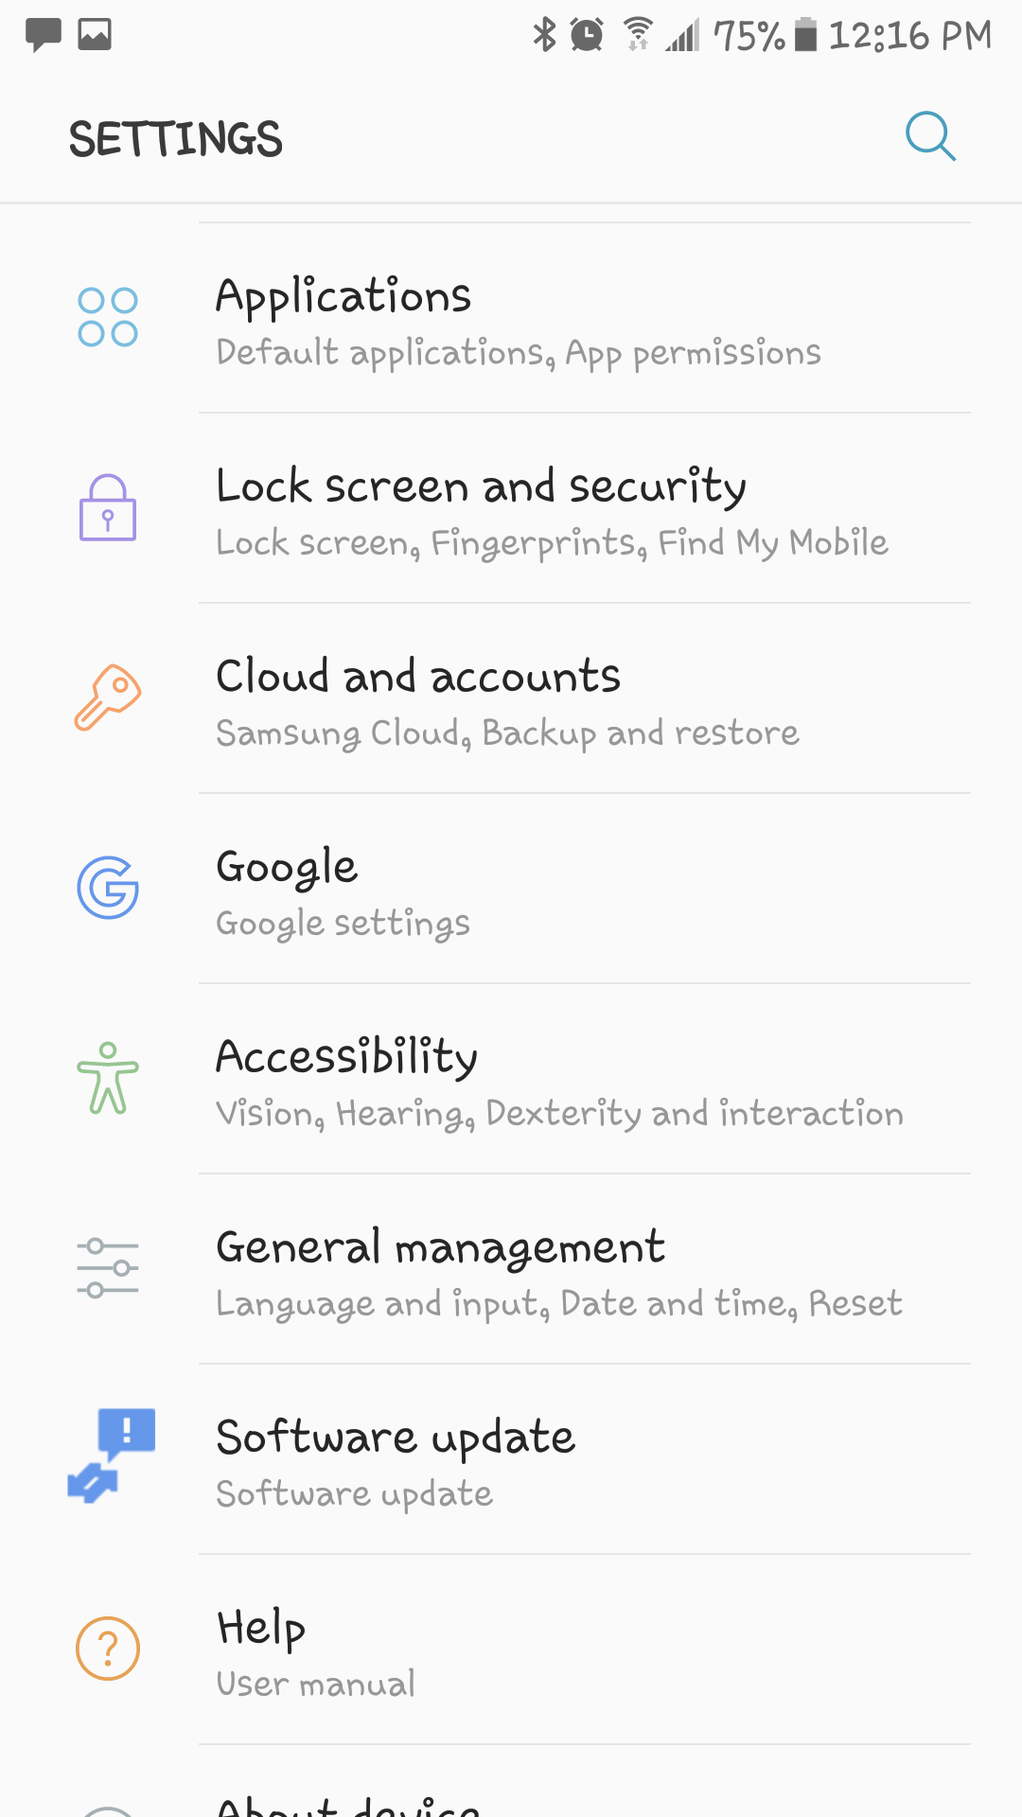
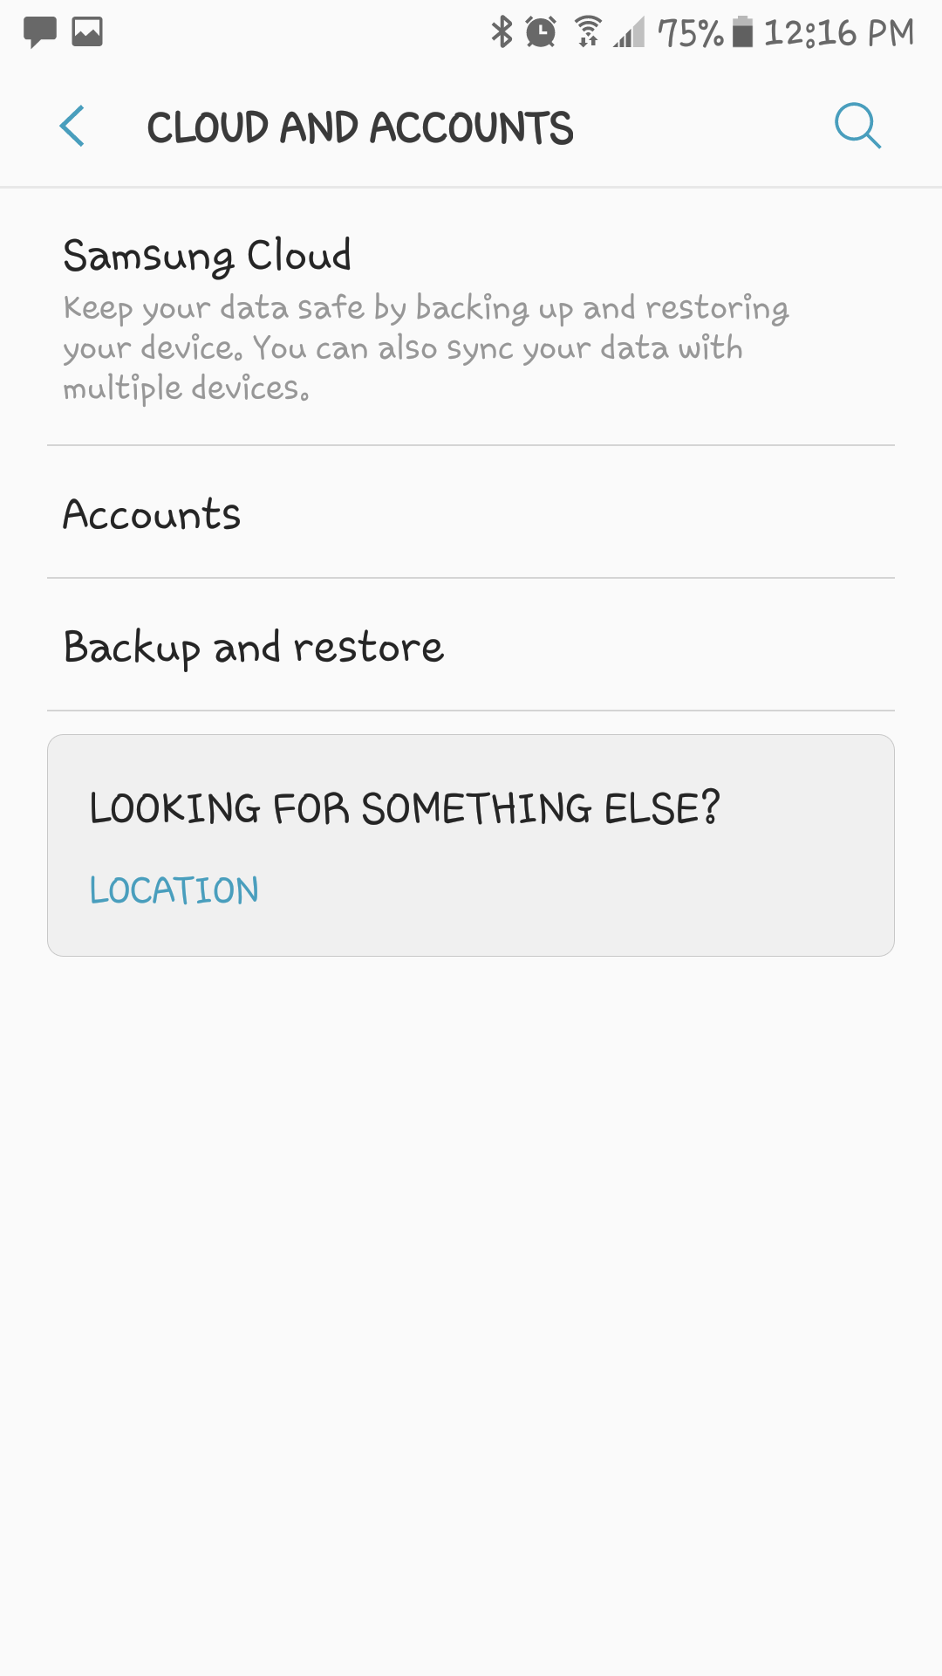

Slide 6
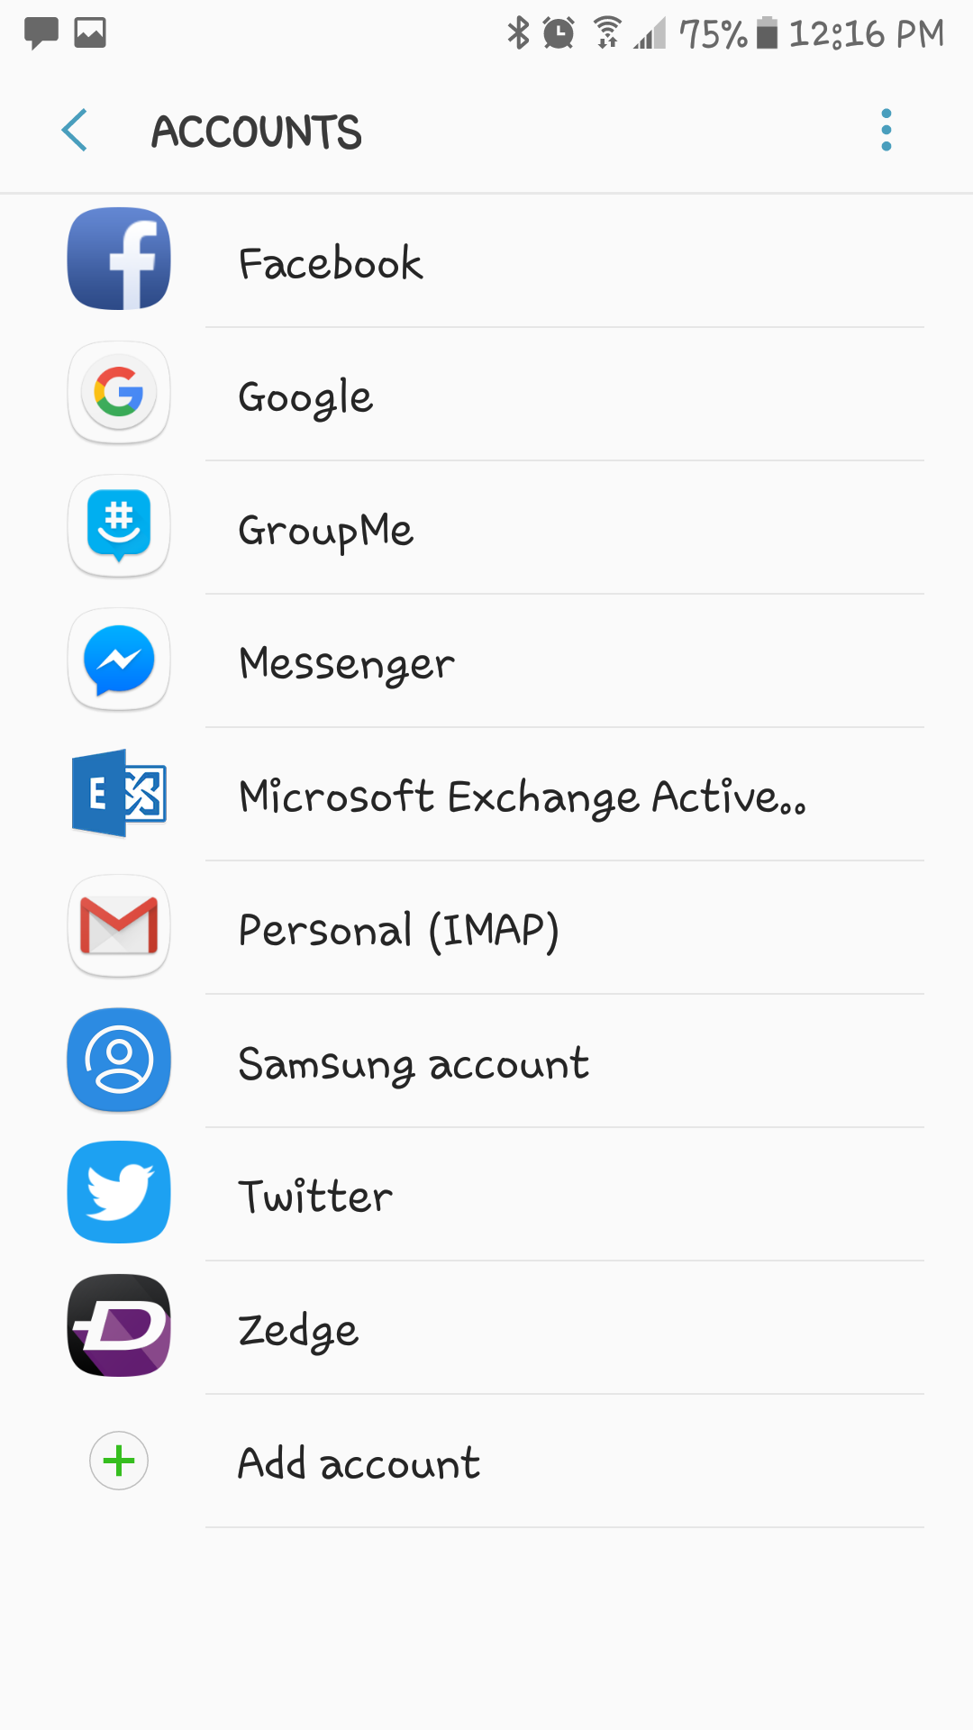
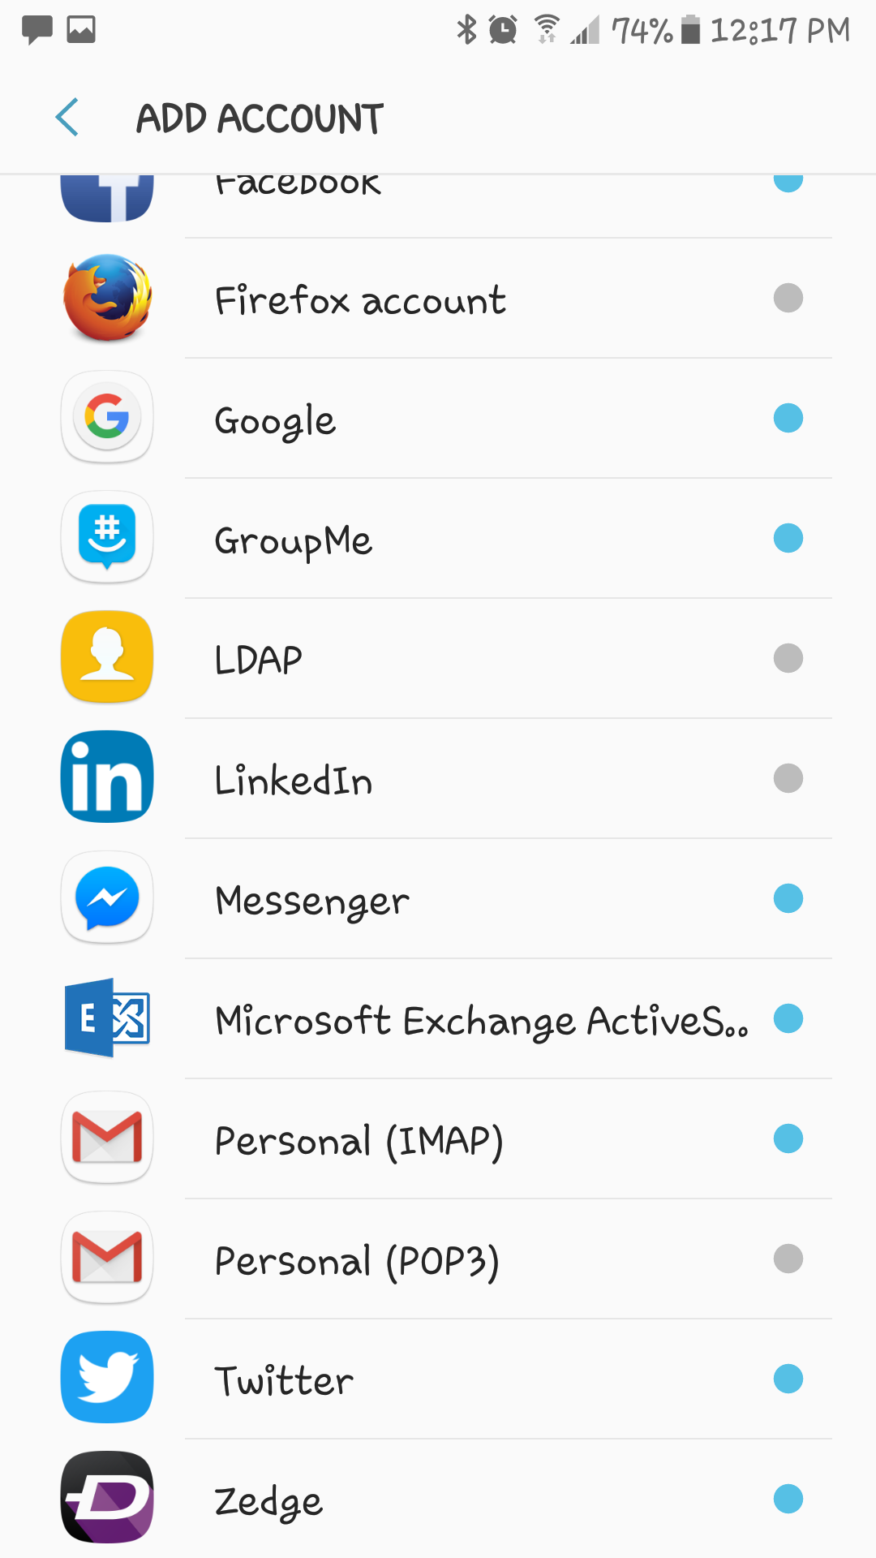
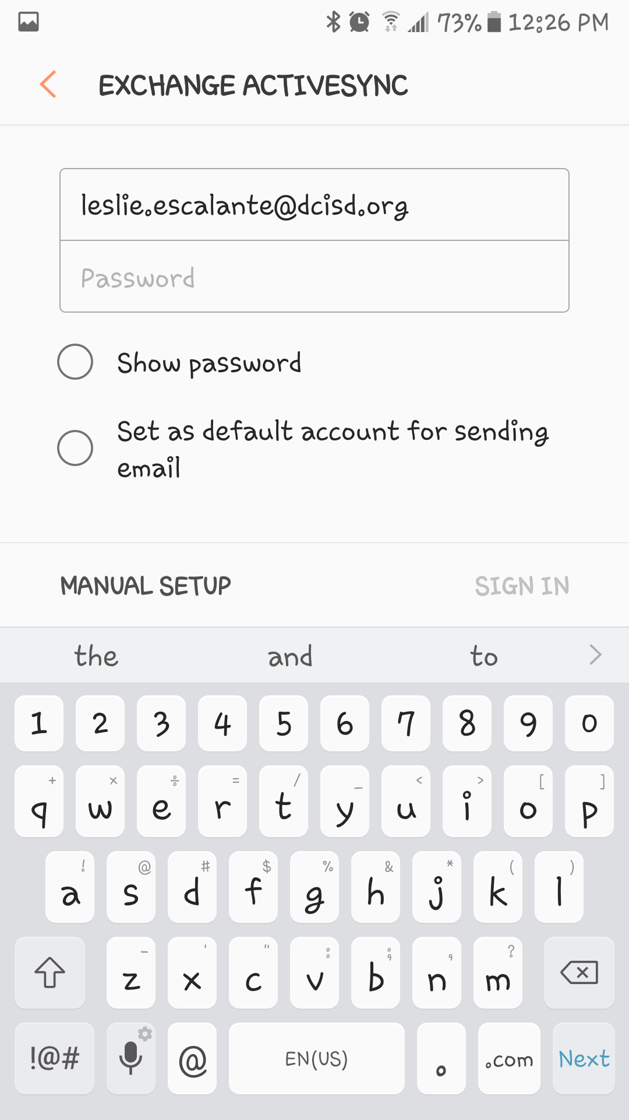

Slide 7
Add New Email Account
Exchange Address
Mail Server = mail.dcisd.org
Domain = dcisd.org
User Name = Same as School
Password = Same as School

Slide 8
Outlook Web Access

Slide 14
Adding a Printer

Slide 18
DCISD Spam Filter

Slide 26
DCISD Internet Filter

Slide 27
Children's Internet Protection Act (CIPA)
The protection measures must block or filter Internet access to pictures that are: (a) obscene; (b) child pornography; or (c) harmful to minors (for computers that are accessed by minors).

Slide 28
EMPLOYEE AGREEMENT FOR ACCEPTABLE USE OF THE DISTRICT’S TECHNOLOGY RESOURCES

Slide 33
Google Classroom classroom.google.com

Slide 34
Do not create your own google user name and password for district purposes.
We (Technology) will create your google account using DCISD.ORG
Your personal gmail account will not allow you to use Google Classroom.
Keep personal account and District account completely separate.

Slide 35
DCISD Home Page

Slide 37
DCISD Special Links

Slide 39
Eduphoria

Slide 44
Website

Slide 53
Do not give your User Name and Password to a Student!!

